Slide 1
APUSH Review: “Bleeding Kansas”
Everything You Need To Know About “Bleeding Kansas” To Succeed In APUSH

Slide 2
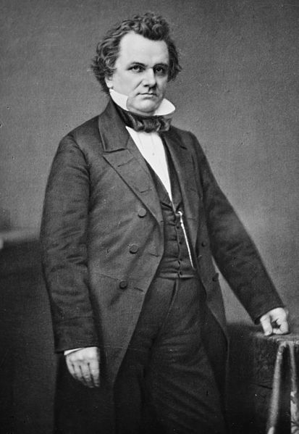
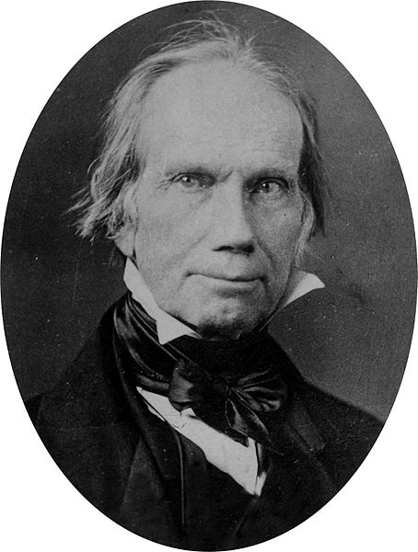
Kansas-Nebraska Act (1854)
1854 Law that allowed for popular sovereignty in the Kansas and Nebraska Territories
Devised by the “Little Giant” Stephen Douglas
The expectation was that Kansas would be slave, Nebraska would be free
Overturned the Missouri Compromise
Many in the North were upset
Helped lead to the creation of the Republican Party
Stephen, why are you overturning my compromise bro?

Slide 3
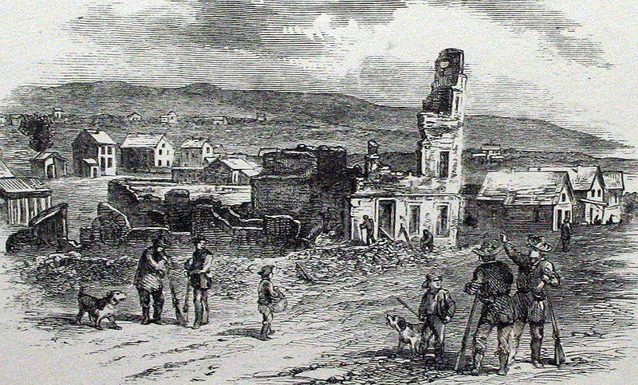
Lawrence, Kansas
Free-Soil city
Burned by pro-slavery individuals
Exhibited the tensions in KS over popular sovereignty and slavery

Slide 4
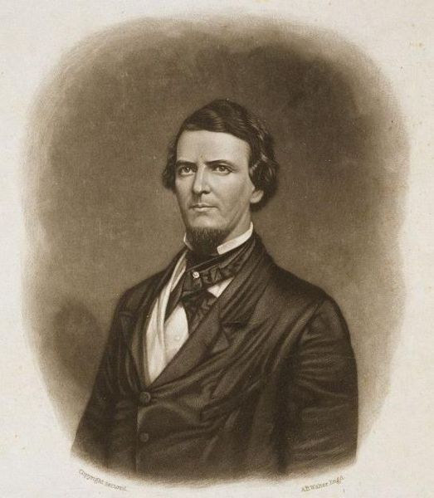
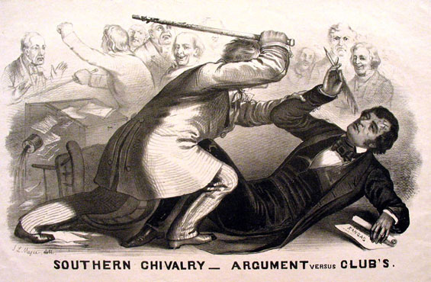
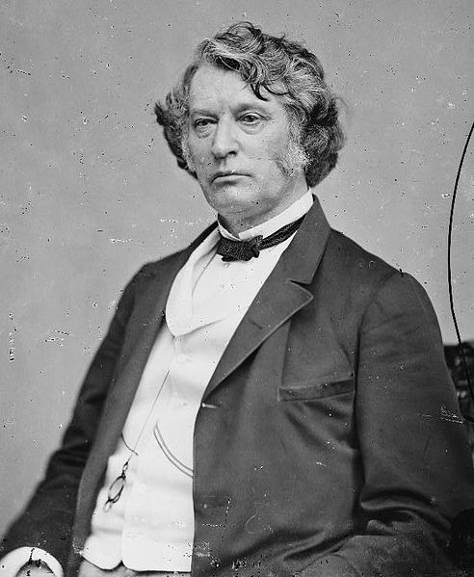
Caning of Charles Sumner
Who was Charles Sumner?
Senator from Massachusetts
Abolitionist
Political speech, “Crime against Kansas”, criticized Douglas and Butler, Senator from SC
Enter Preston Brooks:
Relative of Butler
Wanted to defend honor of the South
The caning:
Brooks attacked Sumner at his desk with a cane
Sumner knocked unconscious
Showed deep tensions in Congress between North and South

Slide 5
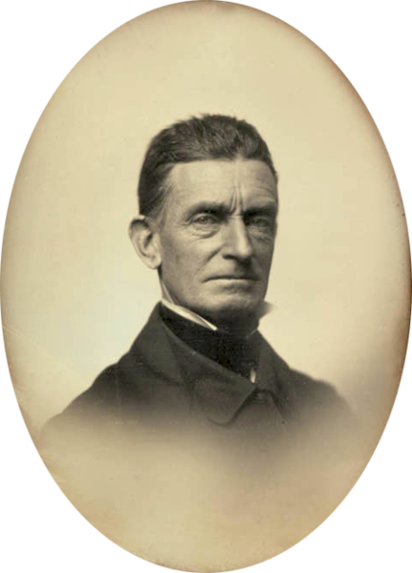
Potawatomie Creek
John Brown (Harpers Ferry fame) and his sons plot revenge for Lawrence and Charles Sumner
He and his followers kill 5 pro-slavery individuals
Brown and his followers leave Kansas
Fighting continues throughout the 1850s

Slide 6
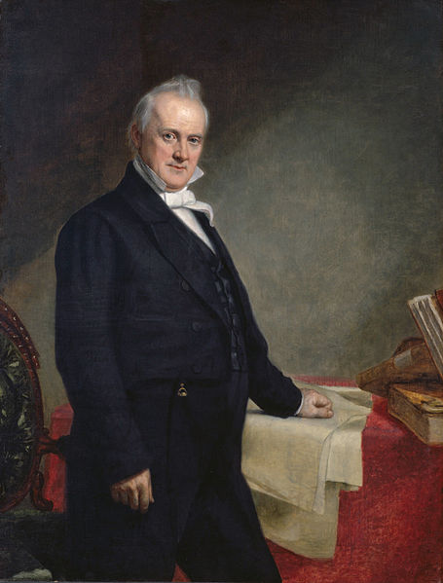
Lecompton Constitution
Kansas applied for statehood
Voters could vote for a constitution with or without slavery
HOWEVER, if they voted without slavery, those slaves that were already in Kansas could stay and be slaves
Sham election
Free-Soilers refuse to vote
President Buchanan supports the Constitution
Kansas does not become a state until early 1861, as a free state

Slide 7
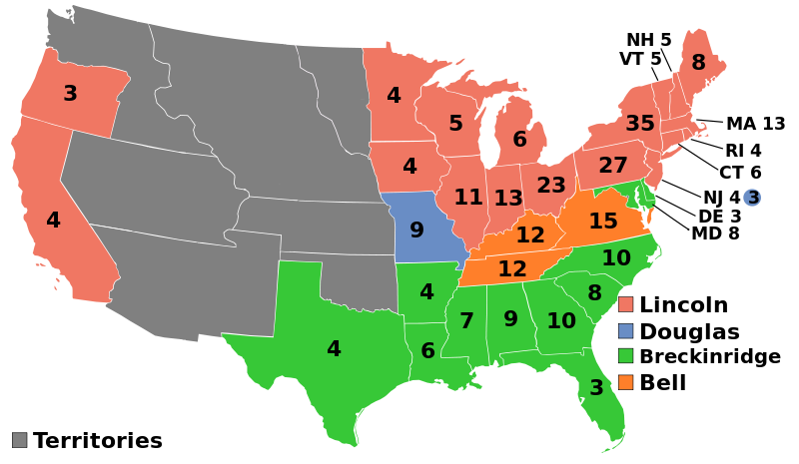
Impact of “Bleeding Kansas”
Democratic Party split along sectional lines
Northern Democrats:
Stephen Douglass
1860 election all but guarantees the Democrats would not win
Abe Lincoln (Republican Party) wins the election
Civil War begins shortly after

Slide 8
Thanks for watching!
Subscribe to my channel
Help spread the word
Questions? Comments? Ideas for videos?
Leave in comments
If you found the video helpful, please press the “Like” button.
Subscribe
Down here!

